Slide 1


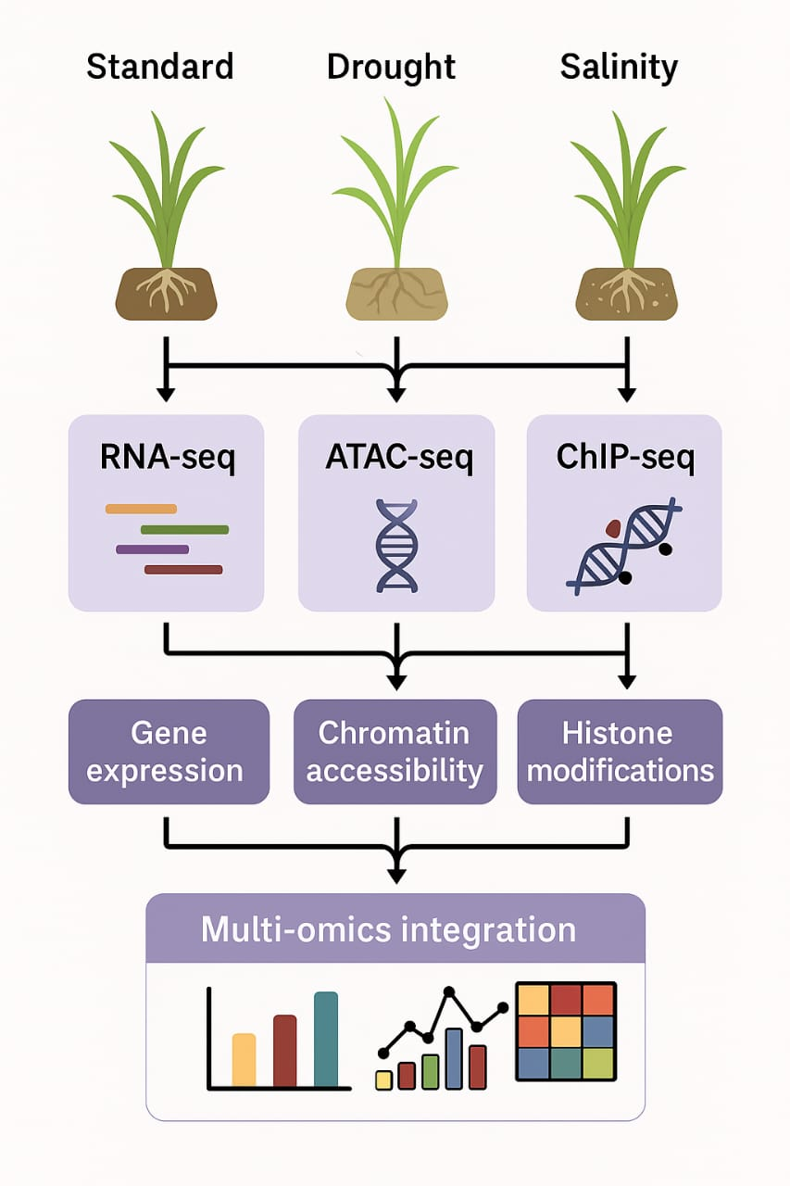
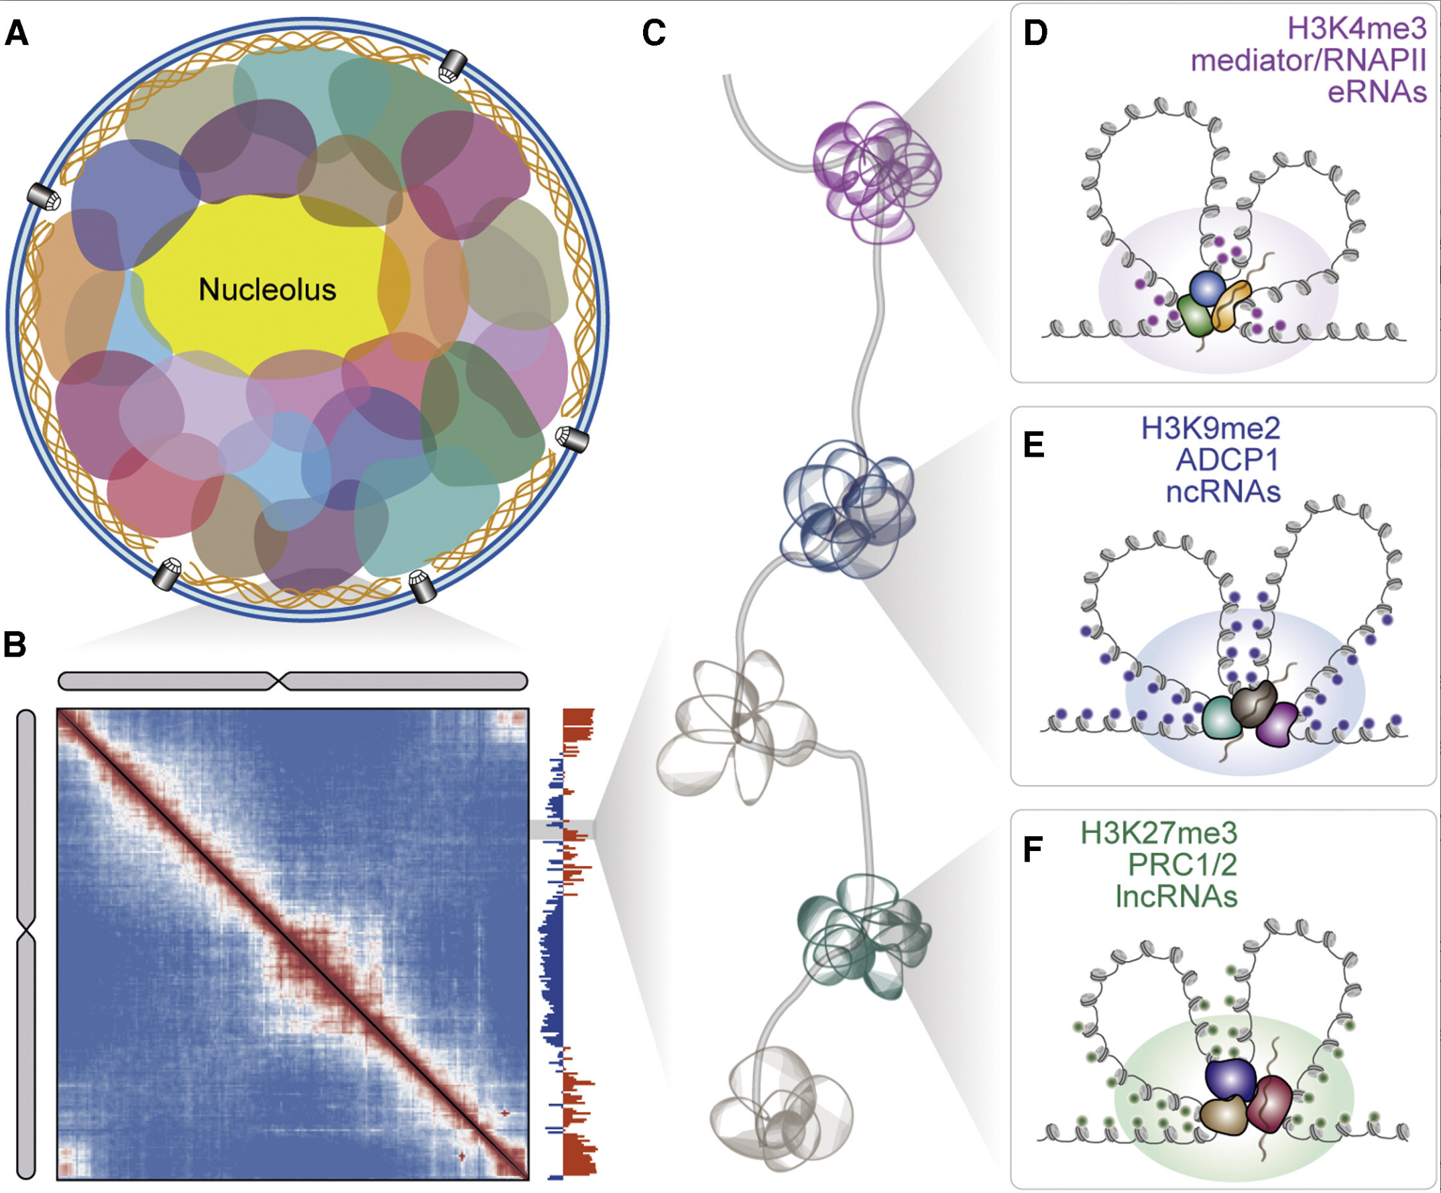
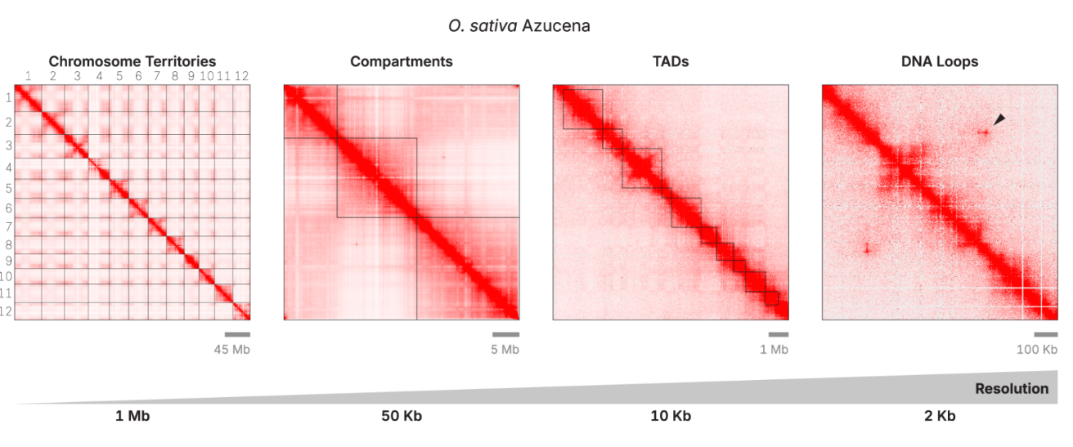
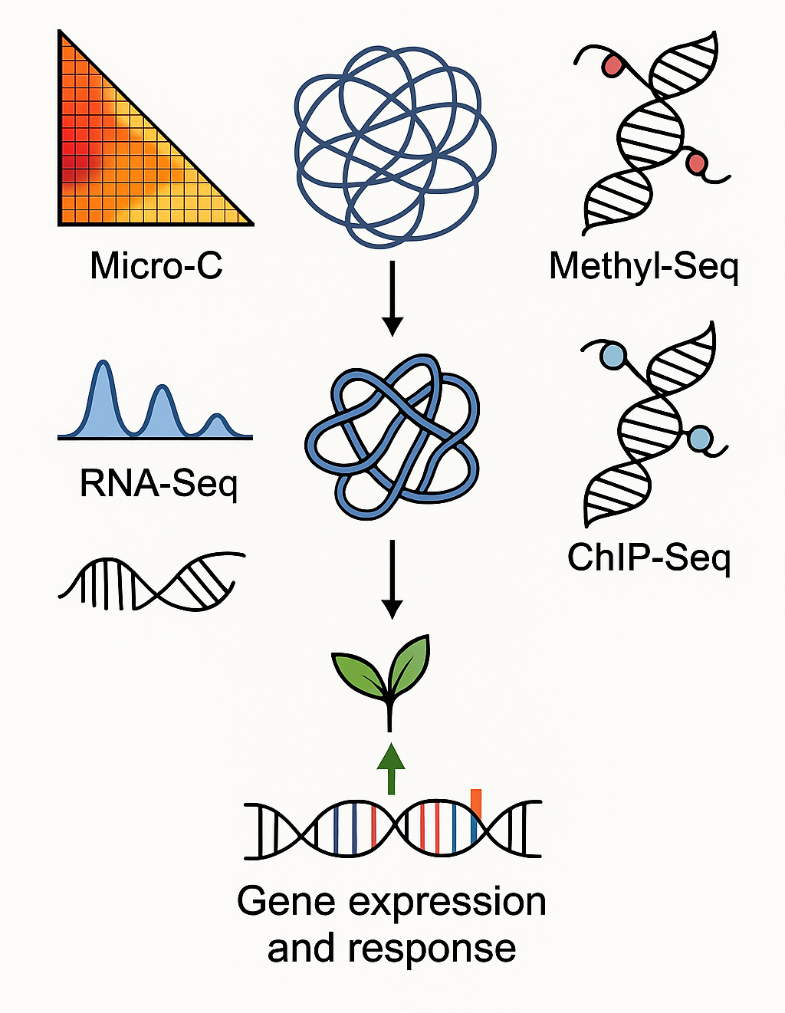
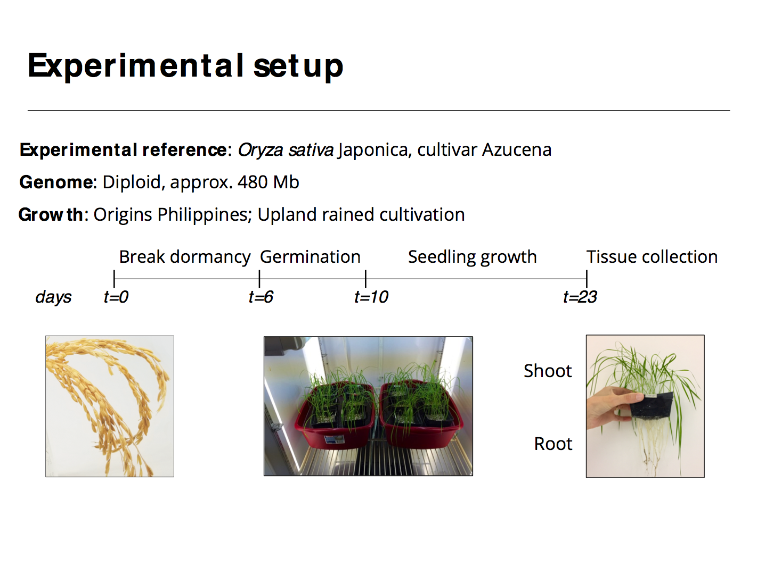

3D Chromatin Architecture and Gene Expression Dynamics of Rice Under Drought and Salinity Stress
John Kaniaru Gitau¹, Zoé Joly-Lopez¹
¹Département de Chimie, Université du Québec à Montréal, Montréal, Québec, Canada
gitau.john@courrier.uqam.ca, joly-lopez.zoe@uqam.ca
Introduction
Study Aims
The three-dimensional organization of chromatin within the nucleus plays a pivotal role in regulating gene expression and coordinating stress responses in eukaryotes. In plants, however, the mechanisms by which chromatin architecture is reorganized in response to environmental stress remain poorly understood¹.
Previous studies in rice (Oryza sativa) have employed both experimental² and computational strategies^{3, 4} to investigate the chromatin landscape and its association with stress-responsive gene expression. Nonetheless, these efforts have often been constrained by limited chromatin resolution and the integration of only a narrow range of functional genomic datasets (e.g., RNA-Seq).
Here, we implement a high-resolution chromatin conformation capture technique, combined with comprehensive integration of multiple functional genomic datasets to delineate stress-specific gene expression.
Aim 1:
Map genome-wide chromatin interactions in rice using Micro-C (Fig.1).
Identify stress-specific changes in topologically associating domains (TADs), chromatin loops, and compartments.
Aim 2:
Integrate 3D genome architecture with functional genomics data (Fig. 5)
Determine the impact of chromatin remodeling on the expression of stress-responsive genes
Figure 2: Data integration model
Figure 1: Chromatin organization in the Rice genome
Functional genomic datasets (Fig. 2) will be overlayed on stress specific 3-D contact maps to delineate stress-specific gene expression
Methods
Figure 5: Multi-Omics data integration
Figure 3: Generating functional genomic datasets
Figure 4: 3-D Contact Maps of rice per condition
Figure 5: Multi-Omics data integration
Plant Material:
Reference genome: Oryza sativa Japonica, Cultivar Azucena
Genome: Diploid, Approx. 480 mb
Break Dormancy
Germination
Tissue Collection
Days
t=0
t=6
t=10
Growth
t=23
Shoot
3D chromatin contact maps (Fig.4) will likely reveal how genome organization changes in rice under control, drought, and salinity conditions. These maps could identify condition-specific TADs, loops, and chromatin interactions that influence gene activity.
Generate three biological replicates per condition from rice shoot tissues
Functional Genomic Dataset | Information obtained
Micro-C | 3D - Chromatin conformation
RNA-Seq | Gene - Expression
Methyl-Seq | Methylation Profile
Chip-Seq | Chromatin Modification
Discussion
Multi-omics data integration is essential for unraveling the complex regulatory landscape governing gene expression and stress responses. By combining 3D genome architecture (Micro-C), DNA methylation (Methyl-Seq), transcriptional output (RNA-Seq), and protein-DNA interactions (ChIP-Seq), we hope to capture a holistic view of chromatin-mediated gene regulation in rice (Fig.5).
This integrative approach will potentially reveal stress-specific chromatin reorganization, aligning with changes in accessibility and transcription factor binding, driving the expression of key drought- and salinity-responsive genes.
Acknowledgements: Labo Joly Lopez Zoe. Figure 1 adapted from Tavallaee & Orouji, 2025
References: ¹Zhang et al., 2024, ²Kumar et al., 2021, ³Chang et al., 2018, ⁴Ding et al., 2023

